Slide 1
Difference in Differences
Hua He
Mar 2022

Slide 2
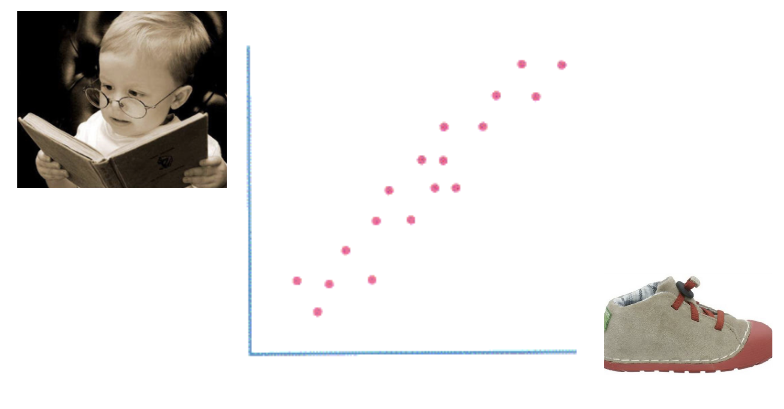
Causal Inference

Slide 3
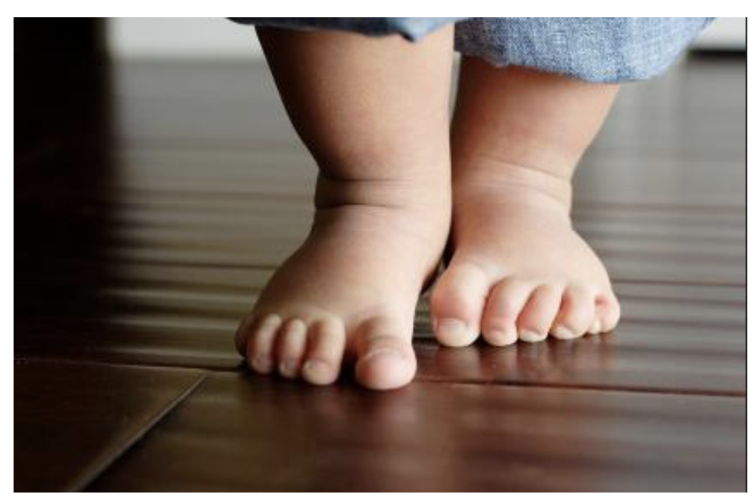

Causal Inference

Slide 4
Causal Inference
Why is cholera mortality rate in some districts lower than in others?
Increasing minimum wage leads to higher unemployment rate?
Which advanced degree brings you the highest ROI?
Children who travel a lot do better at school?
Do CFA charter holders beat the market in investment performances?
Is this business strategy better than others?

Slide 5
What is Difference-in-Differences?
Quasi-experiments where randomized controlled experiment is not an option
Outcome
Identify & quantify causality
Evaluate impact of policies/strategies
Pre
Post

Slide 6
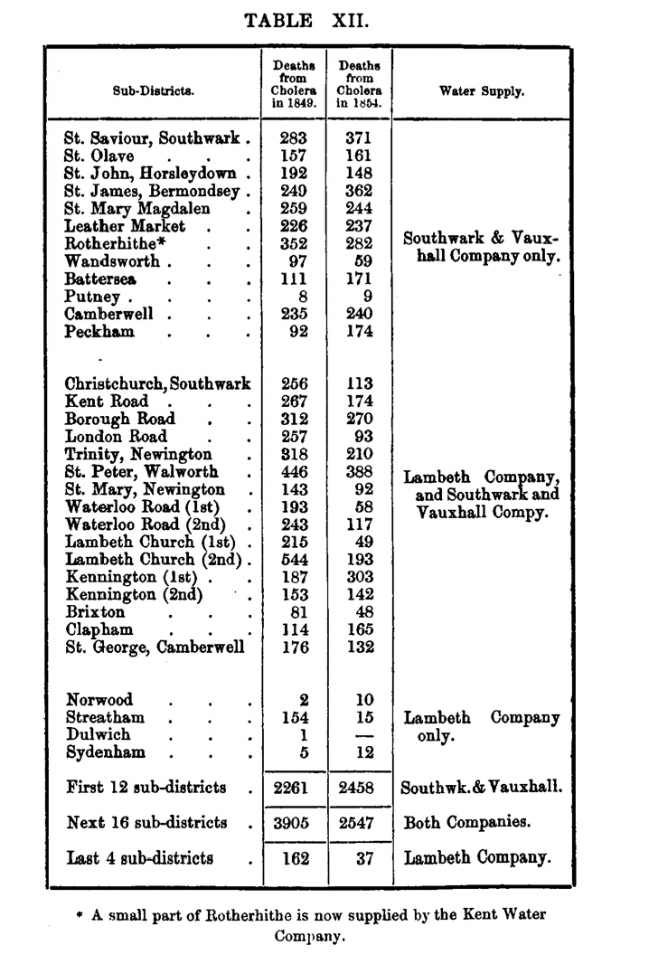

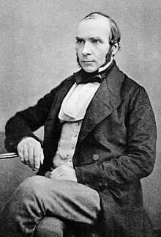
Real World Difference-in-Differences
John Snow

Slide 7
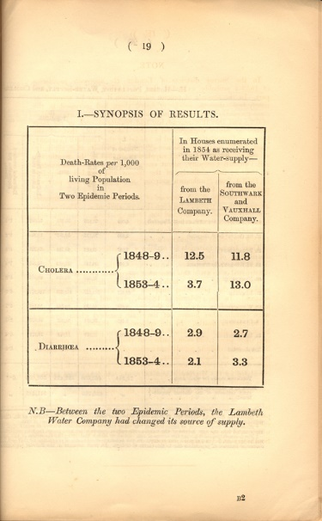
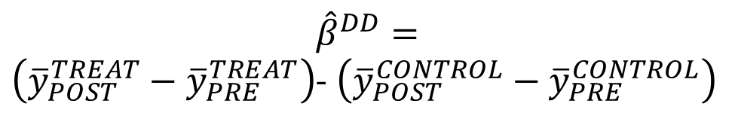
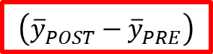
Real World Difference-in-Differences
$${\hat{β}}^{DD}=$$
$\left({\overline{y}}_{POST}^{TREAT}−{\overline{y}}_{PRE}^{TREAT}\right)$- $\left({\overline{y}}_{POST}^{CONTROL}−{\overline{y}}_{PRE}^{CONTROL}\right)$
Treatment
Control
PRE
POST
$$\left({\overline{y}}_{POST}^{}−{\overline{y}}_{PRE}^{}\right)$$
-8.8
1.2
-8.8 – 1.2 = -10

Slide 8


Real World Difference-in-Differences
David Card
Alan Krueger

Slide 9

Time to crunch some numbers…

Slide 10
Real World Difference-in-Differences
Minimum Wages and Employment: A Case Study of the Fast-Food Industry in New Jersey and Pennsylvania
By David Card and Alan B. Krueger (1993)
Conclusion: No indication that the rise in the minimum wage reduced employment
Why:
Offset influence through non-wage compensation
Reduced on-the-job training and flattened tenure-wage profile
Increased prices
Other implications:
Full-time vs part-time composition might have changed
May have discouraged new businesses
Inconclusive influences on demand

Slide 11

2021 Nobel Memorial Prize in Economic Sciences

Slide 12
Pros & Cons of DiD
$$y_{it}=γ_{0}{TREAT}_{i}+γ_{1}{POST}_{t}+{\hat{β}}^{DD}{TREAT}_{i}{POST}_{t}+u_{it}$$
${\hat{β}}^{DD}=\left({\overline{y}}_{POST}^{TREAT}−{\overline{y}}_{PRE}^{TREAT}\right)$- $\left({\overline{y}}_{POST}^{CONTROL}−{\overline{y}}_{PRE}^{CONTROL}\right)$
Intuitive
Needs baseline data
Simple but powerful
Needs parallel trends
Flexible
Compositions of two groups need to be stable
Handles selection bias

